Slide 1
Bluefish Pipeline LLC
Albuquerque Emergency Response
Albuquerque Pipeline, LLC

Slide 2
Code of Regulations
Under 49 CFR §§ 192.605, 192.615, 193.2509, and 195.402, pipeline facility operators must include provisions for coordinating with appropriate fire, law enforcement, emergency management, and other public safety officials in their emergency plans. Immediate contact by pipeline facility operators with local emergency responders located in potentially affected areas provides for appropriate, more coordinated and effective response to emergency situations involving pipelines, and can minimize potential injury, death and environmental damage.
Under §§ 192.616 and 195.440, pipeline facility operators must also develop and implement, and sustain a written public education program that follows the American Petroleum Institute’s (API) Recommended Practice (RP) 1162. Incorporated by reference into §§ 192.616 and 195.440, API RP 1162 further requires operators to provide notice of, and information regarding their emergency response plans to appropriate local emergency officials. These response plans should include information about how emergency officials can determine potential pipeline related risks, and implement appropriate response plans.

Slide 3
Management Commitment

Slide 4
Responding to a Pipeline Emergency
The following guidelines are designed to ensure the safety
of Bluefish response personnel, emergency response personnel, and the general public in the event of a suspected or detected pipeline incident and/or emergency.
Albuquerque Pipeline, LLC

Slide 5
Responding to a Pipeline Emergency
Secure the area for a safe distance.
Eliminate ignition sources such as:
  Open flames or lights
  Electrical switches
  Vehicle ignition
Liquid petroleum products such as jet fuel can migrate to low areas such as ditches, sewers, etc. If safe to do so:
  Evacuate people from homes, businesses, schools and other places of congregation
  Manage access to the site
  Shelter in place if the circumstances make going outdoors dangerous.
If the pipeline leak is not burning:
  DO NOT start motor vehicles or electrical equipment.
  DO NOT ring doorbells.
  DO NOT drive into a leak or vapor cloud.
If the pipeline leak is burning and if safe to do so:
  Attempt to control the spread of the fire, but DO NOT attempt to extinguish a petroleum product or natural gas fire. When extinguished, petroleum products, gas and vapor could collect and explode if reignited by a secondary fire.
Albuquerque Pipeline, LLC

Slide 6
Responding to a Pipeline Emergency
DO NOT operate pipeline valves.
Establish a command center. Work with pipeline representatives as you develop a plan to address the emergency. The pipeline operator will need to know:
  Your contact information and the location of the emergency
  Size, characteristics and behavior of the incident, and if there are any primary or secondary fires
  Any injuries or deaths
  The proximity of the incident to any structures, buildings, etc.
Evacuate or shelter in place.
  Evacuate people upwind or upstream of the incident.
  Consult the pipeline company emergency response officials for evacuation pathing.
Address environmental concerns such as bodies of water, grasslands, endangered wildlife and fish, etc.
Albuquerque Pipeline, LLC

Slide 7
Albuquerque Pipeline, LLC

Slide 8
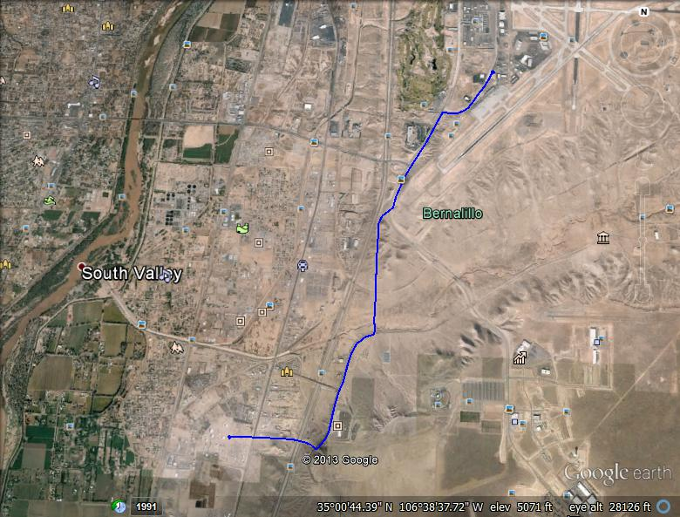
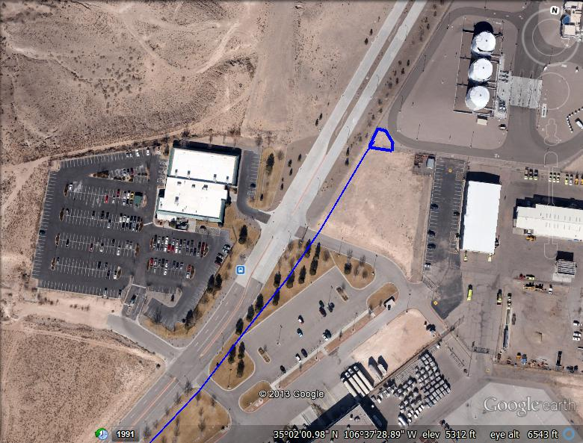
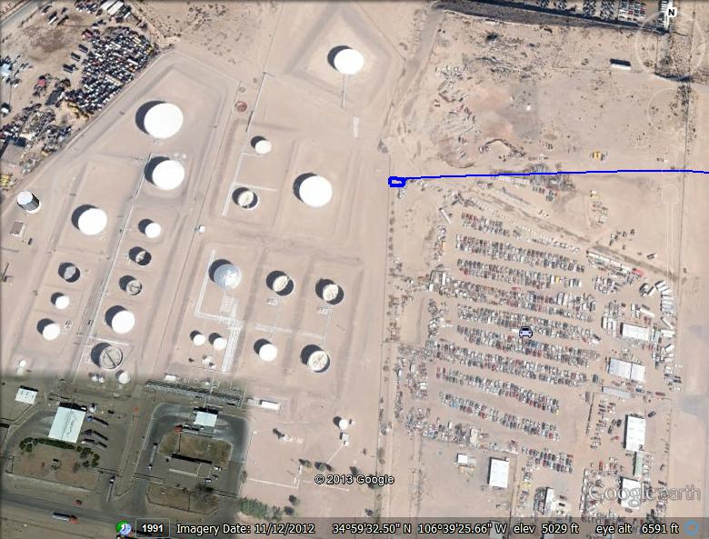
Albuquerque Pipeline - Map
Albuquerque Pipeline, LLC

Slide 9
Albuquerque Pipeline – Technical Details
4 mile pipeline from Nustar terminal to Airport
OD 6” nominal, wall thickness 0.250”
Pipeline Design MAOP 2500 PSI
Normal Operating Pressure 220 PSIG
Two 75 HP Centrifugal Pumps (redundant)
Flowrate 300 to 420 GPM (with newly installed Variable Frequency Drive units)
APL daily runs are scheduled between 7 am – 4 pm Monday – Friday, typical run is between 3 to 5 hours long
System has redundant safety alarms and shut offs, can be monitored remotely
Albuquerque Pipeline, LLC

Slide 10
Albuquerque Pipeline – Information

Slide 11
Albuquerque Pipeline – Product Information
Jet A
  API Gravity 37 – 51
  Gravity .80
  Color Clear and Bright
  Review MSDS
  UN Number 1863 Jet A
  Fire Fighting Section of MSDS
Albuquerque Pipeline, LLC

Slide 12
Albuquerque Pipeline – Physical Locations
Pump Station
5811 Broadway S.E.
Alb. NM 87105
First Gate (White Fence)
Airport Station
3700 block Spirit Dr.
Albuquerque Pipeline, LLC

Slide 13
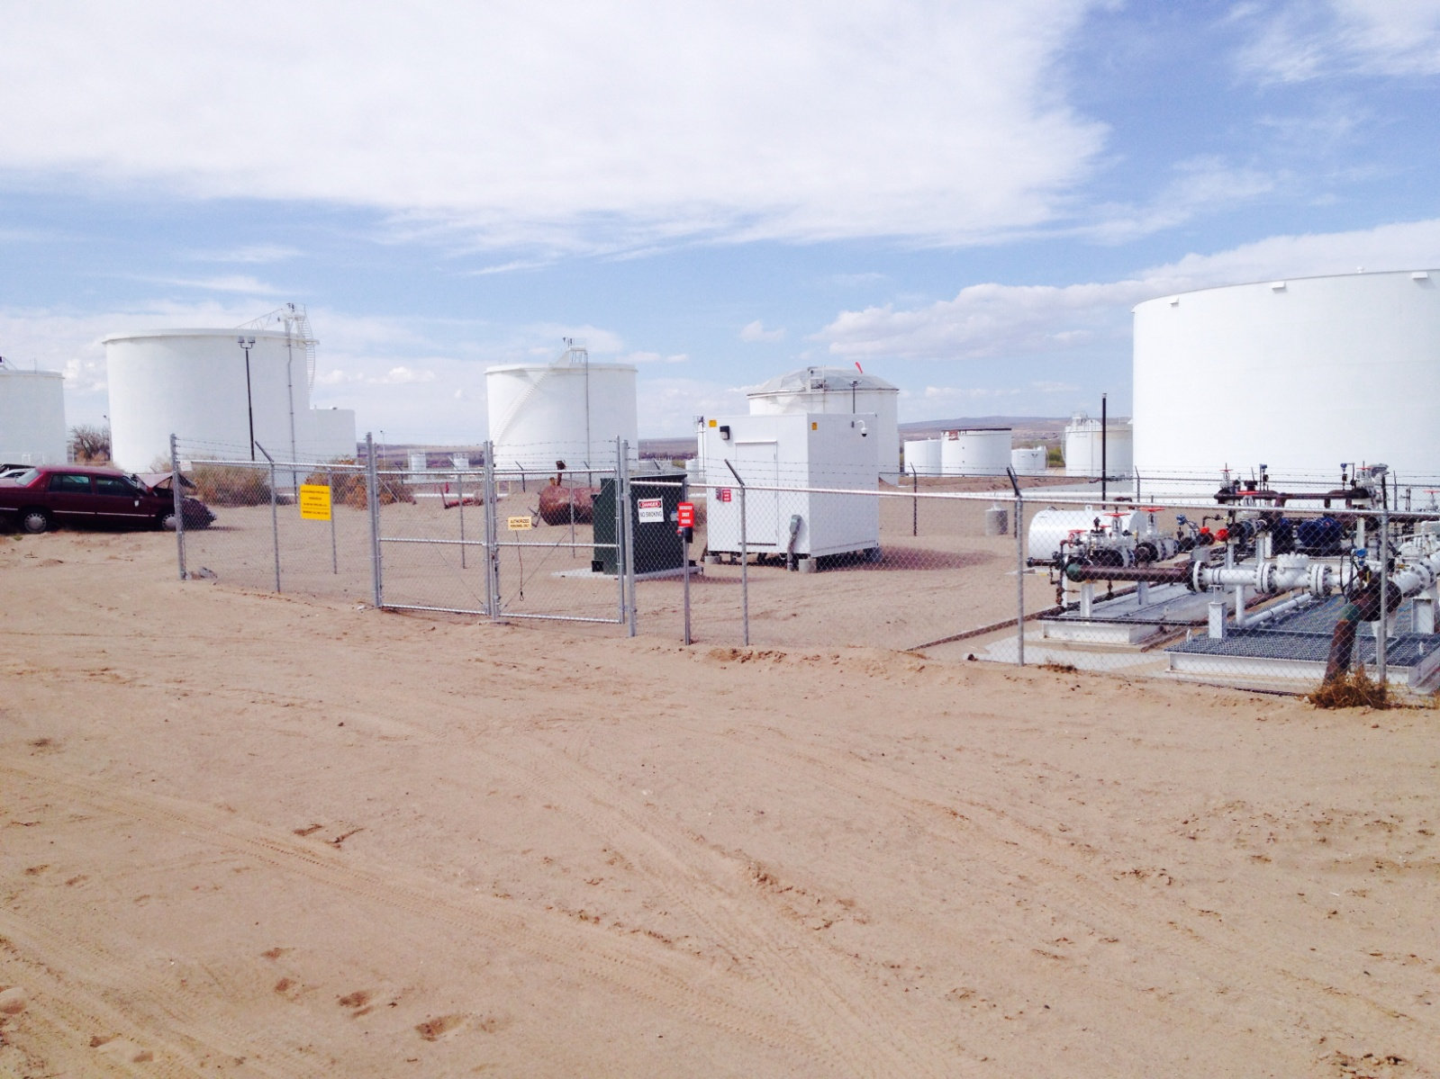
Albuquerque Pipeline - Photos
Albuquerque Pipeline, LLC

Slide 14
Albuquerque Pipeline - Photos
Albuquerque Pipeline, LLC

Slide 15
Albuquerque HCA - Map

Slide 16
Albuquerque Pipeline – Emergency Contact
Bluefish Pipeline Emergency Phone No. 888-312-8851
Advanced Environmental Solutions (Emergency Contractor)
505-861-1700
Scott Lovelace (575) 545-8438
John Degenstein (701) 732-0742
Albuquerque Pipeline, LLC

Slide 17

Albuquerque - Survey
Please take our survey by scanning the QR code.

